Slide 1
Integrating Sensor Networks with Cloud Services
Name: Rushi James Macwan
ECEN 5613 – Embedded System Design
Project Design Review (PDR)

Slide 2
Motivation
The age of wireless communication and recursive control systems has totally changed the face of the world. Automation is being integrated into more and more part of our lives. Embedded Systems, especially the ones strongly interconnected with each other through the various over-the-air transmission methods has brought tremendous development into the field of automation.
Based on this philosophy, I am eagerly looking forward to extend my idea of integrating sensors that measure pollution in the air and bring reliable & efficient information to the end-user through cloud services. Although, some part of what will go into realizing this project is pretty difficult to firmly decide at this point of time but this PDR will focus in a detailed fashion on what the project would look like at the end of the semester.

Slide 3
Project Elements
The project idea in a nutshell is to bring a variety of sensors together and to relay the information in a definite form to a cloud platform which can later provide valuable service in the form of a publish and subscribe system. The major elements that shall form the base of this project are as follows:
The hardware layer – The board that will be developed across the labs over this semester will be used for this project also. In addition to what goes on the board, a few sensors and their filtering elements shall also be added. To integrate the data obtained from these sensors, a communication interface will be established (possibly I2C) to ensure that the data is obtained in a very clear fashion.
Storage elements – I am looking forward to integrate a storage element like an SD card to store the instantaneous data obtained from the sensors before it is sent to the cloud platform. This is a new thing for me but I am eager to learn more about it.
The RF element – To relay the refined data obtained from the sensors to the cloud platform, a proper RF communication channel will need to be established (e.g. GSM module which I had worked upon earlier for my undergrad capstone project).
The Cloud platform – The cloud platform would be something like the cloud foundry services provided by IBM Bluemix. I am working upon it as well in the other class that I am taking this semester and it might be a good fit if I can succeed at making a connection between the two classes by bringing the robust hardware elements on to the cloud platform.

Slide 4
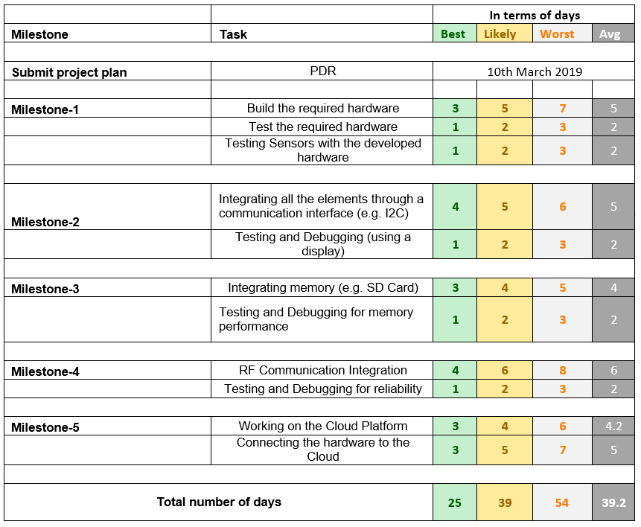
Project Development Plan

Slide 5
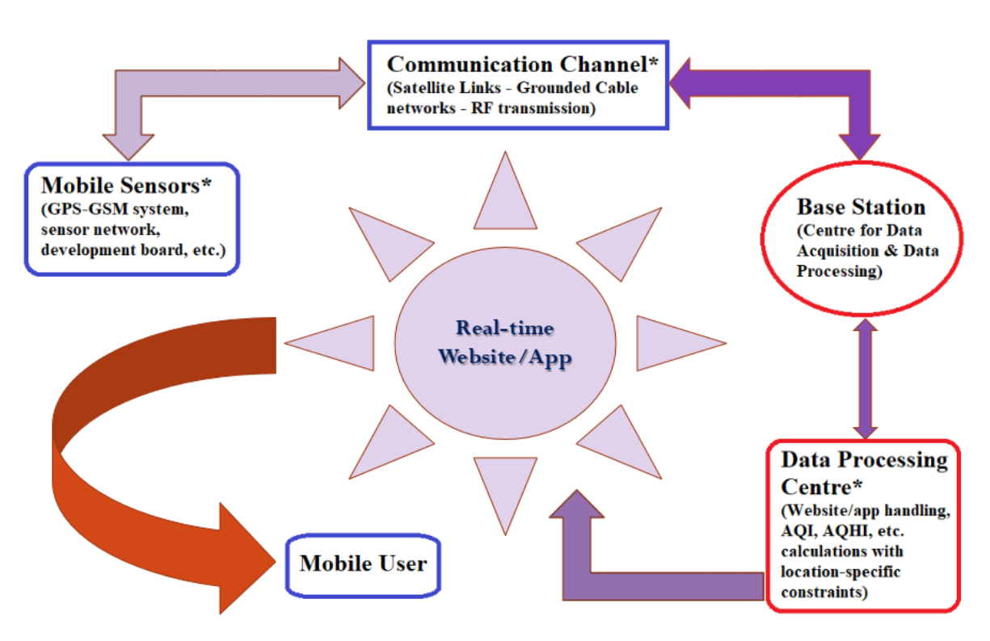
Block Diagram

Slide 6
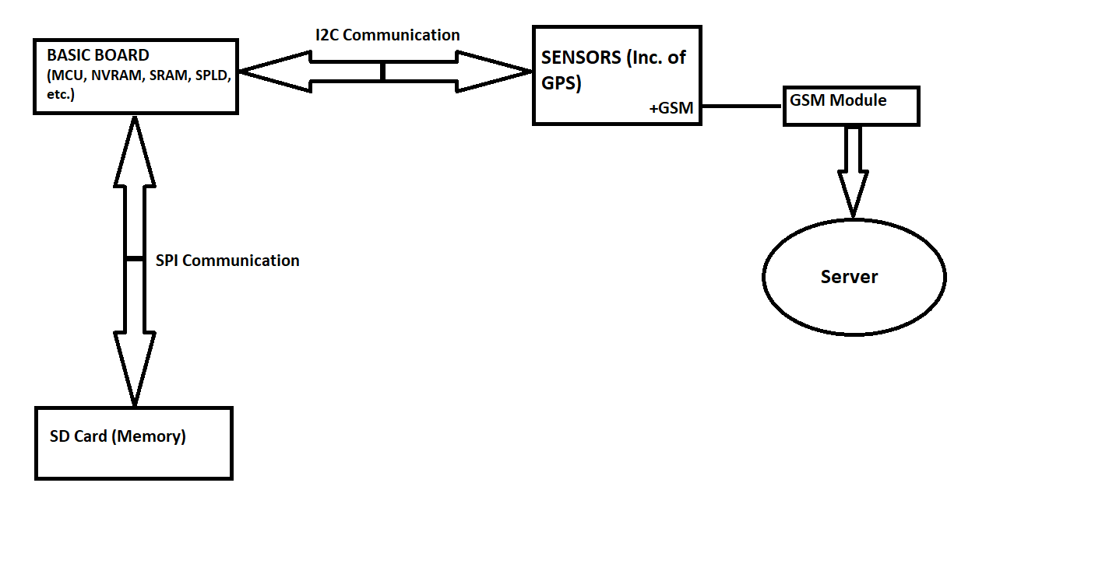
Hardware (Block Diagram)

Slide 7
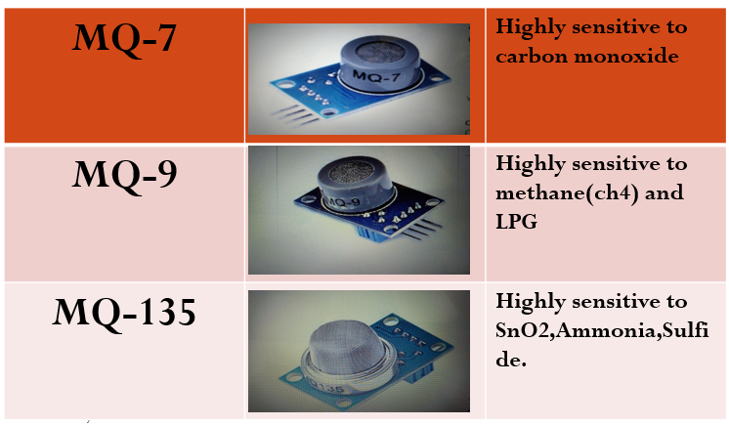
Sensors

Slide 8
Components Summary
Component
Basic Board used throughout the labs
MCU to facilitate I2C communication
SIM800L GPRS-GSM Module
GPS NEO6MV2 Module
Air Pollution Sensors (Hanwei MQ xx Series)
SD Card (Memory)

Slide 9
New software elements to be incorporated
Component
An MCU interface for handling sensor data
New IRQ handlers for the MCU processing sensor data
GPS NEO6MV2 Module software elements – reading location and time
Filtering the sensor data to readable format in terms of some sensible numbers
SD Card (Memory) – software block in the external MCU for handling SD card information
Communication Interfaces Established (e.g. I2C and SPI)

